Slide 1
Superstition wranglers
Mitchell Boullt, Caroline Christy, Alison Faulkner,
Justin Ho, Madison Lusane

Slide 2
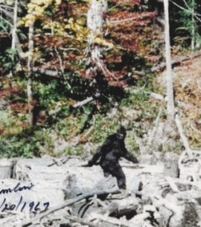
Project Purpose
The purpose of our project is to analyze different paranormal activity such as haunted houses, UFO and Bigfoot sightings.
After we gathered all 3 datasets, we created a combined database to interpret these reports. Our team created maps and graphs to visually interpret our findings by both location and time.
This Photo by Unknown Author is licensed under CC BY-SA

Slide 3
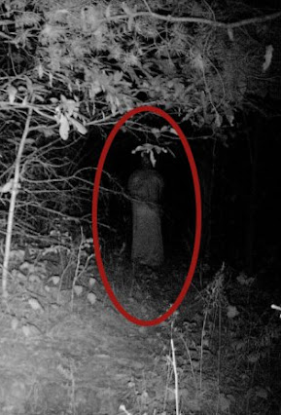
Datasets used
The data we obtained from data.world are:
BigFoot
UFO
Haunted Houses
This Photo by Unknown Author is licensed under CC BY-SA
Notes:
Bigfoot data: 4250 records
UFOs: 138,015 records
Haunted Houses: 10,992 records

Slide 4
Libraries used
CSV
Gmaps
Json
Pandas
Pprint
Requests
Time
Unicodedata
Unicode

